Slide 1
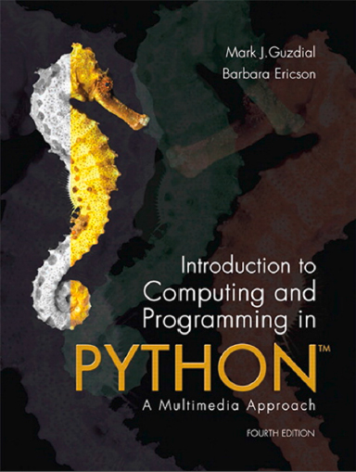
Introduction to Computing and Programming in Python™: A Multimedia Approach
Fourth Edition
Chapter 10
Building Bigger Programs
Slides in this presentation contain hyperlinks. JAWS users should be able to get a list of links by using INSERT+F7
Copyright © 2016, 2013, 2010 Pearson Education, Inc. All Rights Reserved
Notes:
If this PowerPoint presentation contains mathematical equations, you may need to check that your computer has the following installed:
1) MathType Plugin
2) Math Player (free versions available)
3) NVDA Reader (free versions available)
Thanks to John Sanders of Suffolk University for contributions to these slides!

Slide 2
Learning Objectives (1 of 2)
10.1 To demonstrate two different design strategies: top-down and bottom-up.
10.2 To demonstrate different testing strategies, such as black box and glass box.
10.3 To demonstrate several debugging strategies to use when figuring out programming problems.
10.4 To identify challenges to engineering of large programs.

Slide 3
Learning Objectives (2 of 2)
10.5 To use methods for accepting user input and generating output for the user.
10.6 To use an indefinite iteration structure, the while loop.
10.7 To access global variables.

Slide 4
How to Design Larger Programs
Building something larger requires good software engineering.
Top-down: Start from requirements, then identify the pieces to write, then write the pices.
Bottom-up: Start building pieces you know, test them, combine them, and keep going until you have your program
Debugging: Programming is “the art of debugging a blank sheet of paper.”
Testing: Because nothing complicated and man-made is flawless.
Maintenance: By far, the most expensive part of any program.

Slide 5
Top-Down Design
Start from a problem statement. What are you trying to do?
Refine the problem statement. Use hierarchical decomposition to define subparts.
Refine until you know how to write the programs.
Use procedural abstraction so that higher-level functions are written in terms of lower-level.

Slide 6
What’s an Adventure Game?
Text-based, interactive fiction.
Dates back to 1970’s:
http://en.wikipedia.org/wiki/Colossal_Cave_Adventure
See Zork at https://youtu.be/1q9Q2gwqw7U
Play Zork at http://textadventures.co.uk/games/view/5zyoqrsugeopel3ffhz_vq/zork
There are new and updated tools for making interactive fiction like Inform, http://www.inform-fiction.org

Slide 7
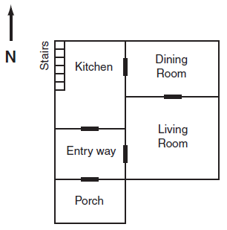
Example Top-Down Design: An Adventure Game
Top-level function:
1. Tell the user how to play the game.
2. Describe the room.
3. Get the player’s command.
4. Figure out the next room.
5. Return to Step 2, until the user Quits.

Slide 8
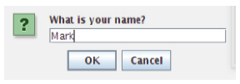

Two New Functions
Takes a string as input, and prints it on the Command Area immediately.
Print waits until the program is done.
Takes a prompt string as input, accepts a string from the user in a dialog window, then returns the user’s input.

Slide 9
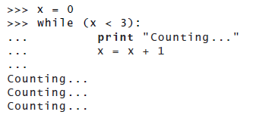
An Important New Loop
How do we keep going, indefinitely, until the user says “quit”?
A while loop repeats a block until a test becomes false.

Slide 10
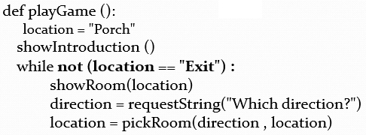
Writing the Top Level Function
Working directly from our earlier outline.
This function makes sense, even without knowing the lower level functions. It is decoupled from the lower-level.

Slide 11
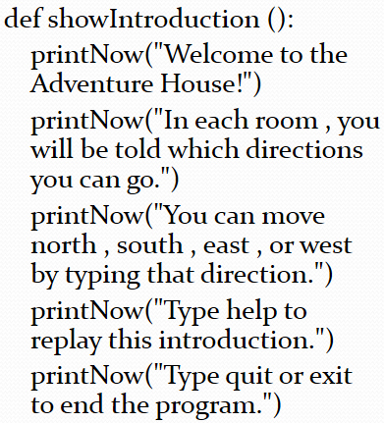
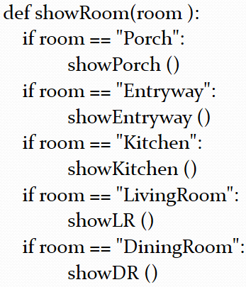
Writing the Subfunctions

Slide 12
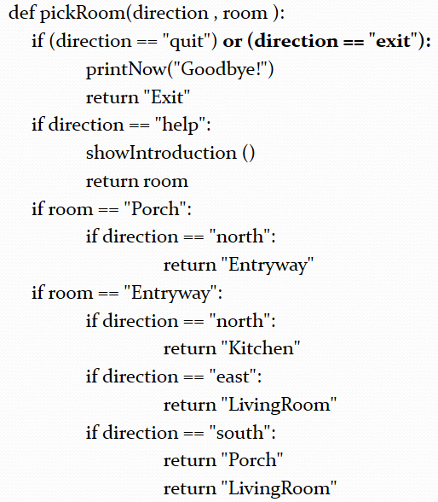
Computer Code Reads, Pick Room Left Parenthesis Right Parenthesis

Slide 13
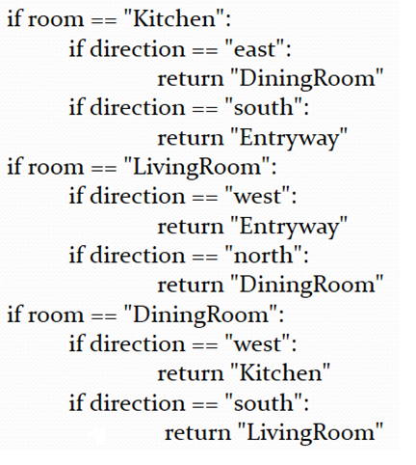
Rest of Computer code reads, pick Room left parenthesis right parenthesis

Slide 14
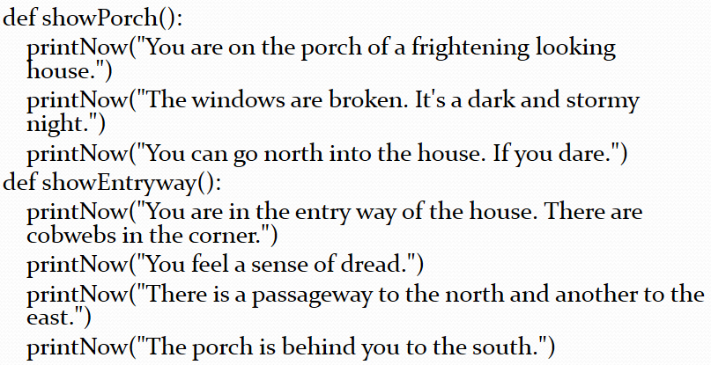
Each Room (Function) Describes Itself

Slide 15
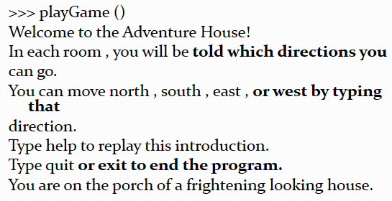
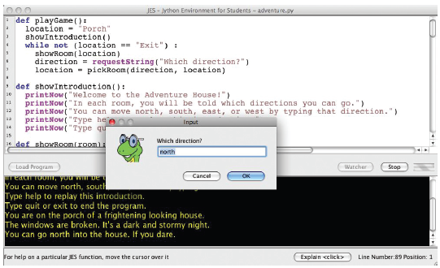
Running Our Program (So-Far)

Slide 16


Testing Our Program
Try both expected, and unexpected input.
We should return something reasonable in response to unreasonable input.

Slide 17
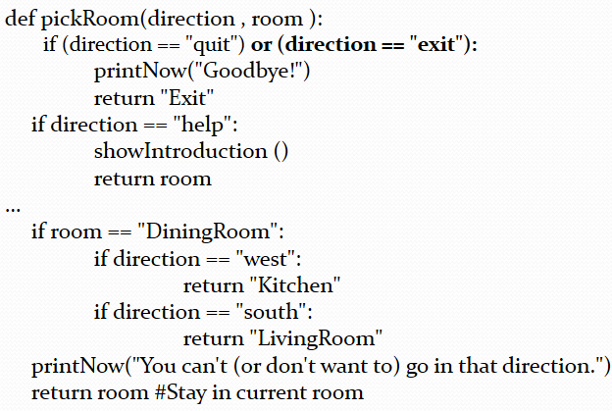
Returning a Reasonable Response to Unreasonable Computer code reads, pick Room left parenthesis right parenthesis Input

Slide 18
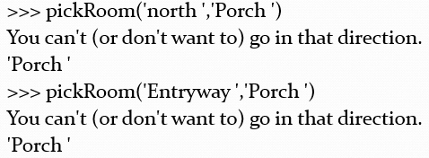
Now We Handle Unexpected Input Better

Slide 19
Tips on Debugging
Learn to trace code
Print statements are your friends
Don’t be afraid to change the program
Use comments to “remove” parts temporarily when testing.

Slide 20
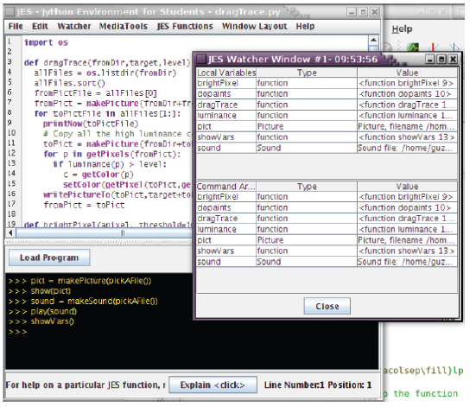
Seeing the Variables: Computer code reads, show V a r s left parenthesis right parenthesis

Slide 21
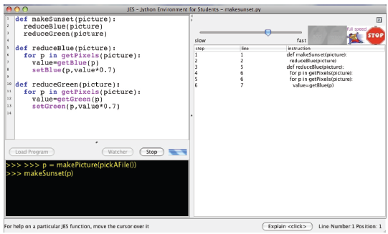
Stepping through Computer code reads, make Sunset left parenthesis right parenthesis with the Watcher

Slide 22
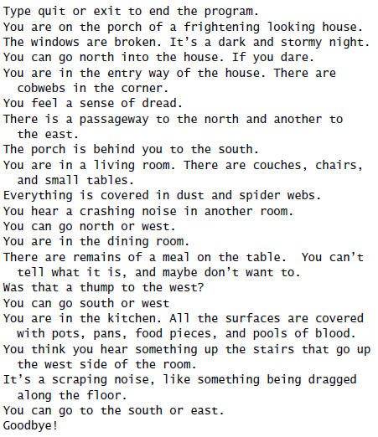
Improving the Adventure Game
When testing, we discover:
It’s hard to tell which room was which when playing the game.
We can’t figure out what we typed where.

Slide 23
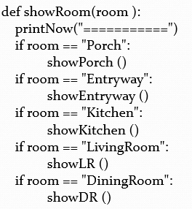
Improving Computer code reads, show Room left parenthesis right parenthesis

Slide 24
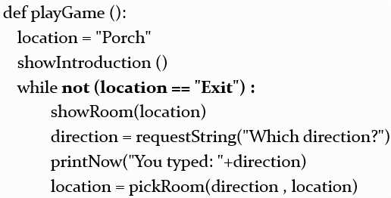
Improving Computer code reads, play Game left parenthesis right parenthesis

Slide 25
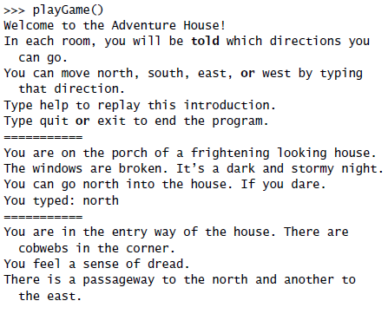
Better Game Play

Slide 26
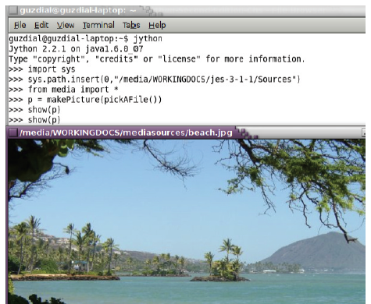
Running Programs Outside of J E S
Once you make a larger program, you may want to run it in Jython directly.
Import sys
Insert the J E S sources into your sys.path
From media import *
That’s it!

Slide 27
How Could We Have Done this Differently?
Store room descriptions and directions in a list.
Easier or harder to change in the future?
Let each room “remember” (store in a data structure) where the exits and other rooms are.
Easier or harder to change in the future?
Let each room be an object that knows how to
Easier or harder to change in the future?

Slide 28
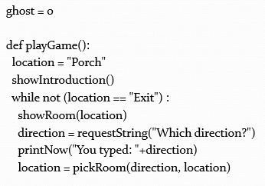
Let’s Add an N P C Ghost!
Non-Player Character: Shows up in some rooms, and moves around.
Create a ghost variable at the top of the file, before the playGame function.

Slide 29
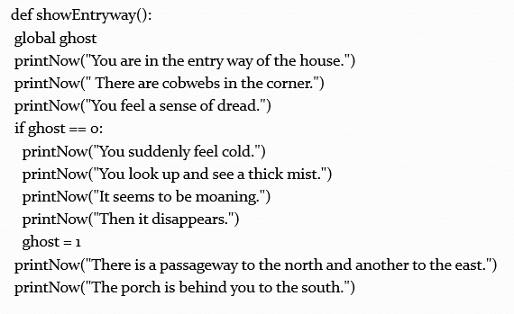
Adding the Ghost to the Entryway

Slide 30
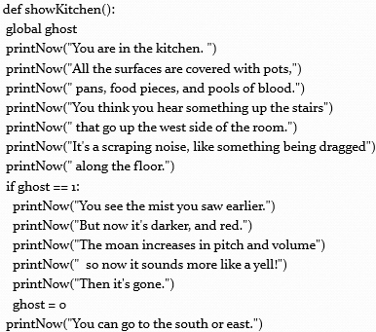
Adding the Ghost to the Kitchen

Slide 31

Copyright

